Slide 1


JAVA INTERVIEW BOOTCAMP
Lecture 11

Slide 2

Today’s Agenda
Assignment Operators
Logical & Relational Operators
Short Circuit Operators
Tricky Interview Questions

Slide 3
Assignment Operator
The assignment operators that we need to know for the Interview are =, +=, -=, *=, and /=.
The +=, -=, *=, and /= operators are short forms of addition, subtraction, multiplication and division with assignment.

Slide 4
Assignment Operator
If you apply these operators to two operands, a and b, they can be represented as follows:
a -= b is equal to a = a – b
a += b is equal to a = a + b
a *= b is equal to a = a * b
a /= b is equal to a = a / b
a %= b is equal to a = a % b

Slide 5
An Important Point!
A compound assignment operator has the following syntax:
variable op= expression
And the following semantics:
variable = (type) ((variable) op (expression))
The type is the data type of the variable
Specially Note the cast and the parentheses implied in the semantics

Slide 6
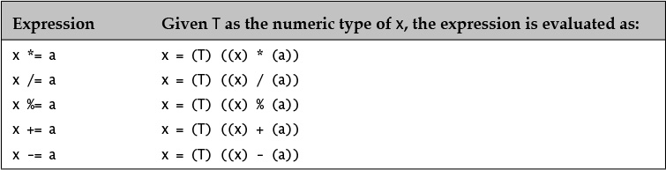
An Important Point!

Slide 7
An Important Point!
A. byte b = 2; b += 10;
// Evaluated as
b = (byte) (b + 10);
B. int a=10; a *= a + 1.5;
// Evaluated as
a= (int)((a) * (a + 1.5));
C. int i = 2; i *= i + 4;
// Evaluated as
i = (int) ((i) * (i + 4));
D. b = b + 10;
// Will not compile. Cast is required.

Slide 8
An Important Point!
int[] a = new int[] { 2015, 2016, 2017 }; int i = 2; a[i] += 1;
// Evaluates as
a[2] = a[2] + 1, and a[2] becomes 2018.

Slide 9
Another Important Point
We know that all byte, short, and char values are automatically widened to int when used as operands for arithmetic operations.
For example:
byte a=10,b=20;
short c=a+b;
Will not compile
But if we modify the preceding example and define variables a and b as final variables, then the compiler is assured that their sum, value 30, can be assigned to a variable of type short, without any loss of precision.
final byte a=10,
final byte b=20;
short c=a+b;
Perfectly OK

Slide 10
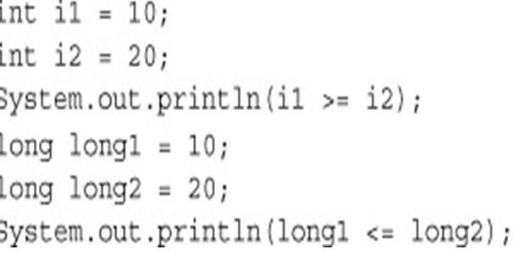
Relational Operators
Relational operators are used to check one condition.
We can use these operators to determine whether a primitive value is equal to another value or whether it is less than or greater than the other value.
false
true

Slide 11
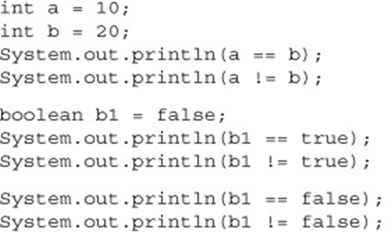
Comparing Primitives
The operators == (equal to) and != (not equal to) can be used to compare all types of primitives like:
char, byte, short, int, long,float, double, and boolean
false
true
false
true
true
false

Slide 12

Comparing Primitives
We can’t apply these operators to incomparable types.
In the following code snippet, the code that compares an int variable to a boolean variable will fail to compile:

Slide 13
Logical Operators
Logical operators are used to evaluate one or more expressions.
These expressions should return a boolean value.
We can use the logical operators AND, OR, and NOT to check multiple conditions and proceed accordingly.

Slide 14
Logical Operators
If we wish to proceed with a task when both the conditions are true, use the logical AND operator, &&.
If we wish to proceed with a task when either of the conditions is true, use the logical OR operator, ||.
If we wish to wish to reverse the outcome of a boolean value, use the negation operator, !.

Slide 15
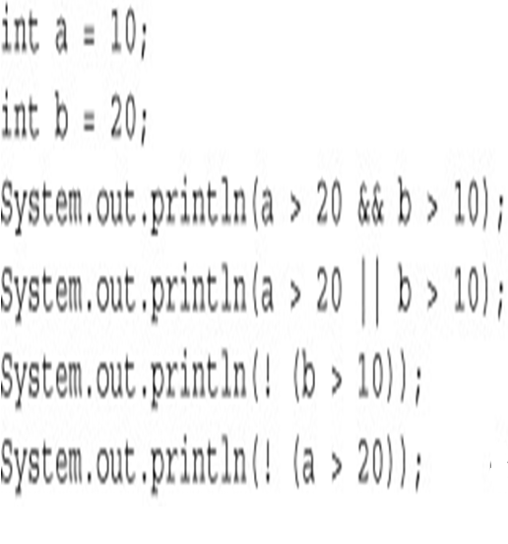
Logical Operators
false
true
false
true

Slide 16
Short Circuit Behaviour
The && operator returns true only if both the operands are true.
If the first operand to this operator evaluates to false, the result can never be true. Therefore, && does not evaluate the second operand.
Similarly, the || operator does not evaluate the second operator if the first operand evaluates to true.

Slide 17
Short Circuit Behaviour
What do you think the output of the following code will be?
int marks=8,total=10;
System.out.println(total < marks && ++marks > 5);
System.out.println(marks);
System.out.println(total ==10&& ++marks > 10);
System.out.println(marks);
Answer:
false
8
false
9

Slide 18
Tricky Interview Questions
1. Given the following declaration:
char c = 'A';
What is the simplest way to convert the character value in c to
an int?
Select the one correct answer.
(a) int i = c;
(b) int i = (int) c;
(c) int i = Character.getNumericValue(c);
Correct Answer:
a

Slide 19
Tricky Interview Questions
2 What will be the result of compiling and running the following program?
public class MyClass { public static void main(String[] args) { String a, b, c; c = new String("mouse"); a = new String("cat"); b = a; a = new String("dog"); c = b; System.out.println(c); } }
Select the one correct answer.
(a) The program will fail to compile.
(b) The program will print mouse at runtime.
(c) The program will print cat at runtime.
(d) The program will print dog at runtime.
(e) The program will randomly print either cat or dog at runtime.
Correct Answer:
c

Slide 20
Tricky Interview Questions
3. Which of the following expressions will be evaluated using floating-point arithmetic?
Select the three correct answers.
(a) 2.0 * 3.0
(b) 2 * 3
(c) 2/3 + 5/7
(d) 2.4 + 1.6
(e) 0x10 * 1L * 300.0
Correct Answer:
a, d and e

Slide 21
Tricky Interview Questions
4. What is the value of the expression (1 / 2 + 3 / 2 + 0.1)?
Select the one correct answer.
(a) 1
(b) 1.1
(c) 1.6
(d) 2
(e) 2.1
Correct Answer:
b

Slide 22
Tricky Interview Questions
5. Which of these assignments are valid?
(a) short s = 12;
(b) long l = 012;
(c) int other = (int) true;
(d) float f = -123;
(e) double d = 0x12345678;
Correct Answer:
a, b,d,e

Slide 23
Tricky Interview Questions
6. What happens when you try to compile and run the following program?
public class Prog1 { public static void main(String[] args) { int k = 1; int i = ++k + k++ + +k; // (1) System.out.println(i); } }
Select the one correct answer.
(a) The program will not compile, because of errors in the expression at (1).
(b) The program will compile and print the value 3 at runtime.
(c) The program will compile and print the value 4 at runtime.
(d) The program will compile and print the value 7 at runtime.
(e) The program will compile and print the value 8 at runtime.
Correct Answer:
d

Slide 24
Tricky Interview Questions
7. What will be the result of compiling and running the following program?
public class EvaluationOrder { public static void main(String[] args) { int[] array = { 4, 8, 16 }; int i = 1; array[++i] = --i; System.out.println(array[0] + array[1] + array[2]); } }
Select the one correct answer.
(a) 13
(b) 14
(c) 20
(d) 21
(e) 24
Correct Answer:
a

Slide 25
Tricky Interview Questions
8. What is the output of the following code?
public class Foo {
public static void main(String[] args) {
int a = 10;
long b = 20;
short c = 30;
System.out.println(++a + b++ * c);
}
}
A. 611
B. 641
C. 930
D. 930
Correct Answer:
A

